Slide 1
Range Testing of RSU
Debashis Das
04/12/2019

Slide 2
Outline
Purpose of Range testing
Roadside Unit (RSU)
Onboard Unit (OBU)
DSRC Radio
Basic Safety Message (BSM)
Testing Plan
Testing Approach on field
Data Collection
Generate KML files
Google Earth Plot
Analysis

Slide 3
Purpose of Range Testing
Evaluate the RSU locations by measuring BSMs receiving range of the RSU on the locations

Slide 4
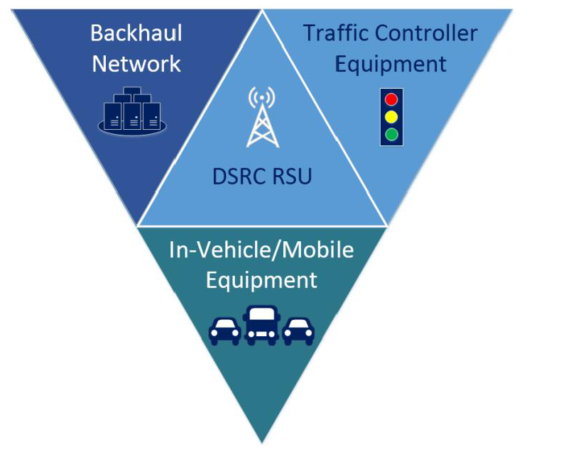
Roadside Unit (RSU)
Roadside Units (RSU) are deployed in connected vehicle systems to facilitate the communication between vehicles and transportation infrastructure and other devices by transferring data over DSRC in accordance with the industry standards.
The DSRC Roadside Unit can also be
integrated with a backhaul system to
enable remote management.
An RSU can be integrated with local traffic
control systems to improve the traffic
management services to vehicles and other
mobile devices.

Slide 5
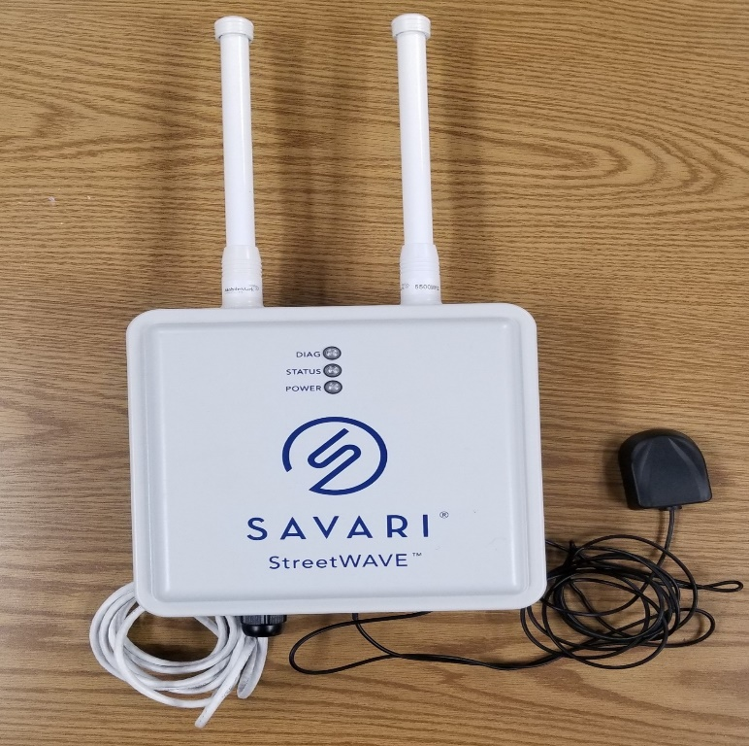
Roadside Unit (RSU)
The RSU hardware used for Range testing was supplied by Savari, Inc. and is called the StreetWave unit.
There are other manufacturers of RSUs – Cohda, Leer, etc.

Slide 6
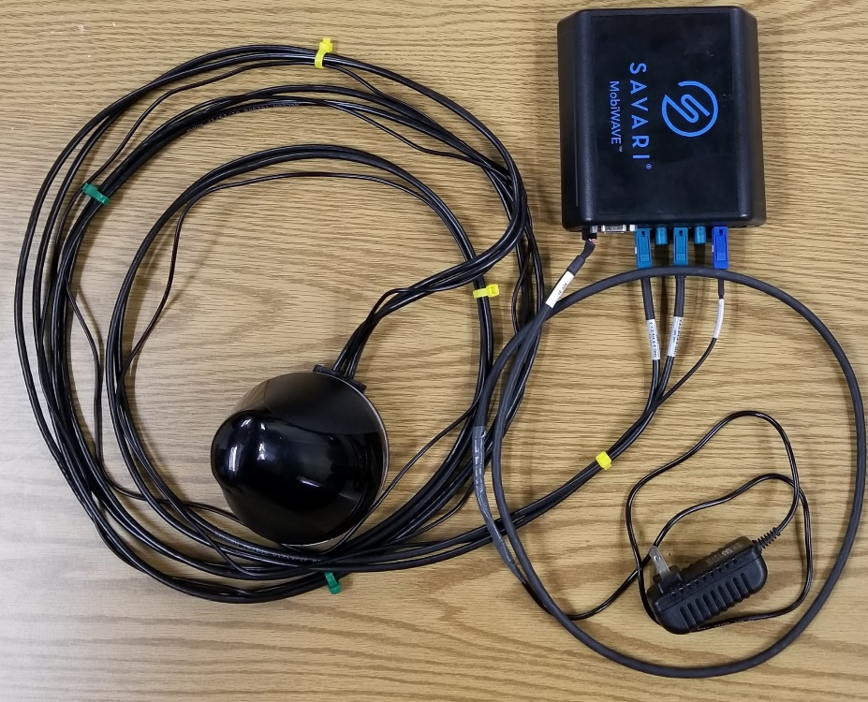
Onboard Unit (OBU)
Onboard Unit (OBU) is a hardware device that is deployed on the vehicle to exchange messages with the RSU based on the SAE J2735 standard using the Dedicated Short Range Communications (DSRC) standards.
The OSU hardware used for Range testing was supplied by Savari, Inc. and is called Savari MobilWave units.

Slide 7
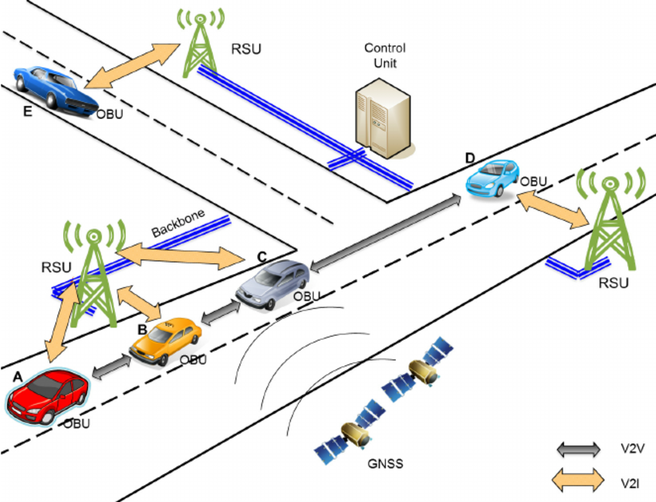
DSRC Radio
The following figure demonstrates the V2V and V2I Communication via DSRC radio.
Source:https://www.researchgate.net/publication/287406124_Sensing_Traffic_Density_Combining_V2V_and_V2I_Wireless_Communications/figures

Slide 8
Basic Safety Message (BSM)
The Basic Safety Message (BSM) is transmitted 10 times per second from an OBU. A BSM message has two parts:
BSM Part 1:
Contains the core data elements (vehicle size, position, speed, heading acceleration, brake system status)
BSM Part 2:
Contains a variable set of data elements drawn from many optional data elements.
The BSM is transmitted over DSRC has a minimum range of 300 meters. Experience has shown that this range can be as much asy 1,000 meters.

Slide 9
Range Testing Objective
Locate an RSU at a candidate installation location in the field
Drive a vehicle with an OBU that is broadcasting BSMs along the roadway segment
Received the BSMs on the RSU at the candidate location when the vehicle is in the range of the RSU
Evaluate the range and roadway coverage of the RSU at the candidate location.

Slide 10
Testing Procedure
Step 1: Set up the RSU in the field and connect it with the external computer (computer-1) through the Ethernet cable.
Step 2: Set up the OBU on the vehicle and connect it with the external computer (Computer-2) through the Ethernet cable.
Step 3: Run the software (bsmreceiver.py) in the external computer (computer-1) to collect the BSMs.
Step 4: Log into OBU via external computer (Computer-2) and monitor the status of the OBU( whether it is sending BSMs or not) .

Slide 11
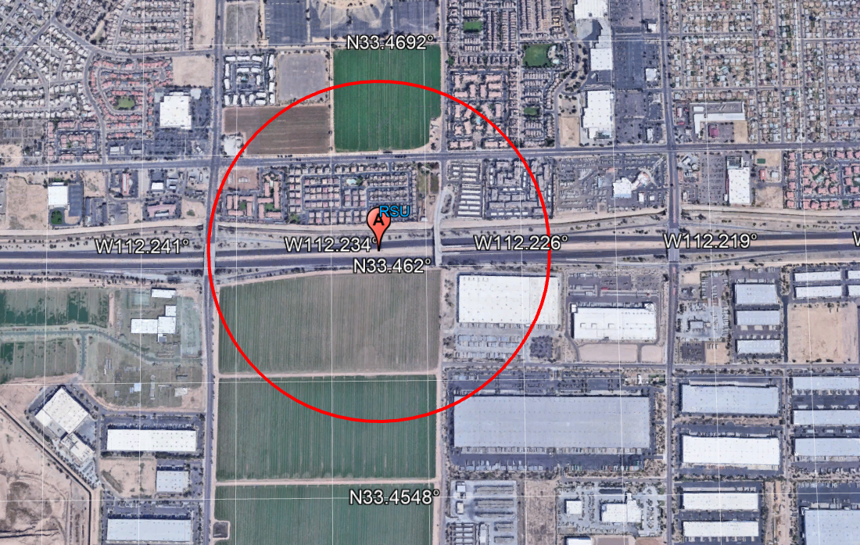
Test Procedure – Location 1
RSU was mounted near the DMS of freeway of west I-10 at Location-1.

Slide 12
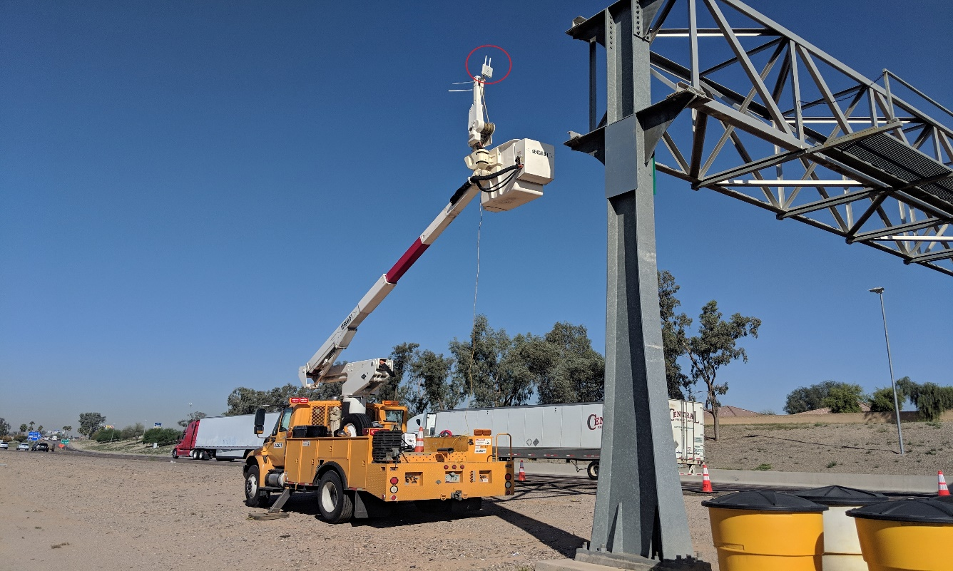
Test Procedure - Location 1
RSU was mounted near the DMS of freeway of west I-10 at Location-1.

Slide 13
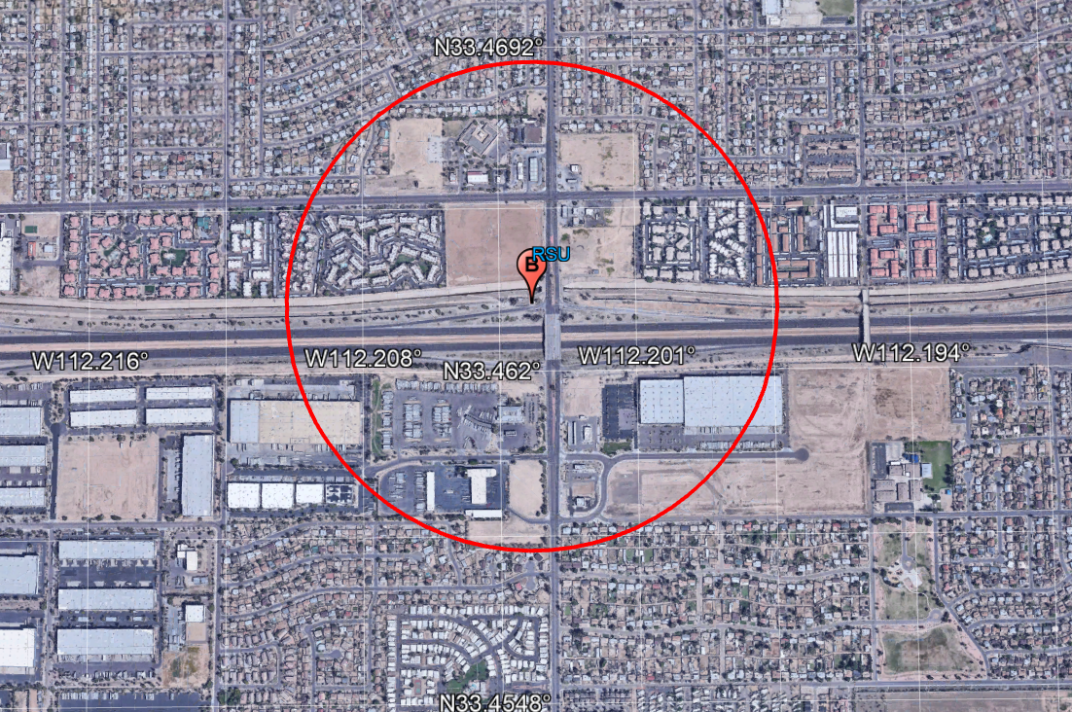
Test Procedure – Location 2
RSU was mounted near junction of 67 Ave and west I-10 at location-2.

Slide 14
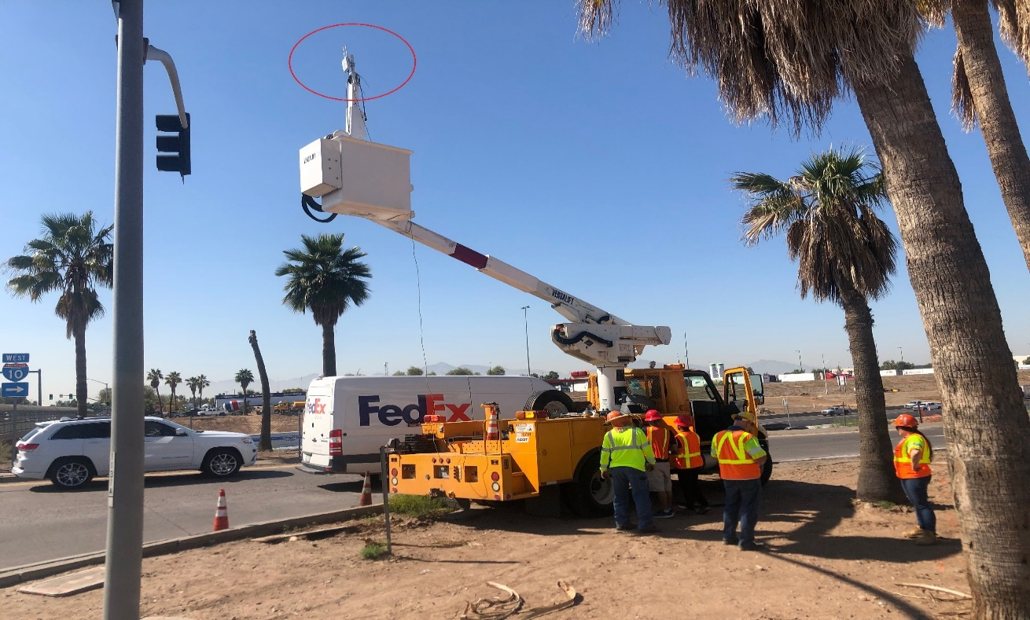
Test Procedure – Location 2
RSU was mounted near junction of 67 Ave and west I-10 at location-2.

Slide 15
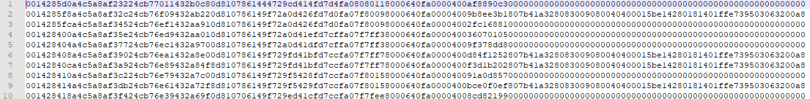
Data Collection
After mounting the RSU, a python script was run to collect and store all the received BSMs in the external computer(Computer-1).
More than three thousand BSMs were received by the RSU at each location.
Figure: Received BSMs

Slide 16
Data Collection
All the collected BSMs were decoded by using the MMITSS J2735 library to obtain the GPS points from each BSM.
Vehicle ID | Latitude | Longitude | Elevation | Speed(kmh) | Heading
691104299 | 33.4628098 | -112.2267247 | 281.8 | 96 | 269
691104299 | 33.4628065 | -112.2270139 | 281.8 | 97 | 269
691104299 | 33.4628062 | -112.2270429 | 281.8 | 97 | 269
691104299 | 33.4628059 | -112.2270717 | 281.8 | 97 | 269
691104299 | 33.4628056 | -112.2271007 | 281.8 | 97 | 269
691104299 | 33.4628052 | -112.2271295 | 281.8 | 97 | 269
691104299 | 33.4628049 | -112.2271584 | 281.8 | 97 | 269
691104299 | 33.4628047 | -112.2271871 | 281.8 | 97 | 269
691104299 | 33.4628044 | -112.227216 | 281.8 | 97 | 269
691104299 | 33.4628039 | -112.2272449 | 281.8 | 97 | 269
691104299 | 33.4628035 | -112.2272737 | 281.8 | 96 | 269
691104299 | 33.4628032 | -112.2273026 | 281.8 | 97 | 269
691104299 | 33.4628029 | -112.2273315 | 281.8 | 97 | 269
691104299 | 33.4628026 | -112.22736 | 281.8 | 96 | 269
691104299 | 33.4628022 | -112.2273887 | 281.8 | 96 | 269
691104299 | 33.4628016 | -112.2274177 | 281.8 | 97 | 269
691104299 | 33.4628012 | -112.2274467 | 281.8 | 97 | 269
691104299 | 33.4628007 | -112.2274756 | 281.8 | 97 | 269

Slide 17
Generate KML file
A python script has been written to generate a KML file for the GPS points obtained from the decoded BSMs.

Slide 18
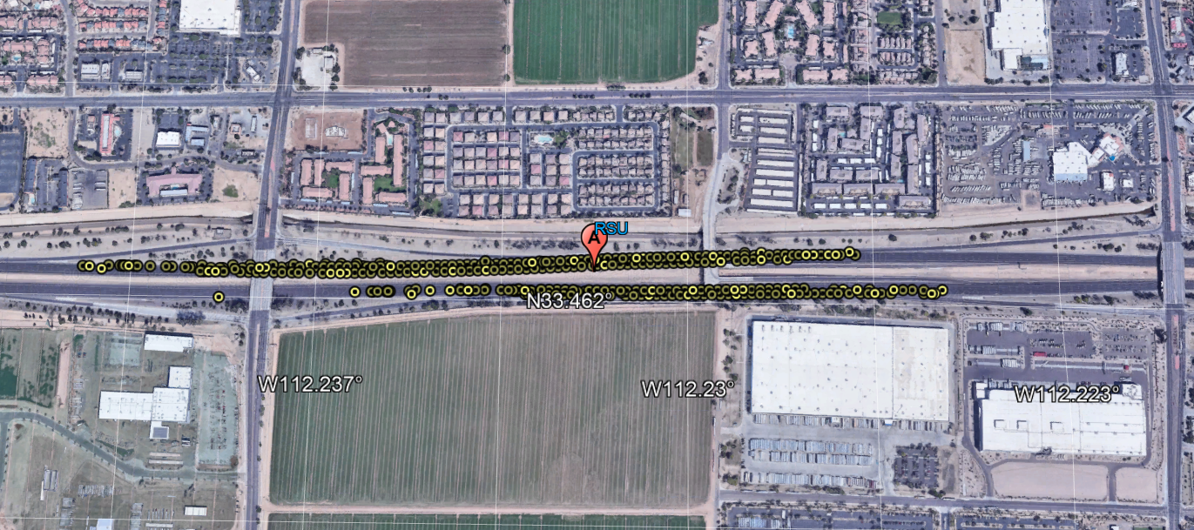
Google Earth Plot
The KML file is viewed in Google Earth Pro.
Point A denotes the location of the RSU at location-1 and all yellow marks indicates the vehicle location.

Slide 19
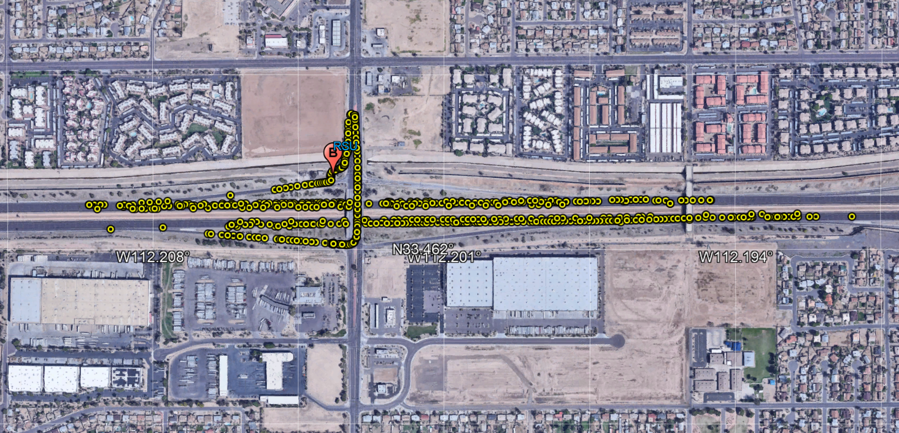
Google Earth Plot
The KML file is viewed in Google Earth Pro.
Point A denotes the location of the RSU at location-2 and all yellow marks indicates the vehicle location.

Slide 20
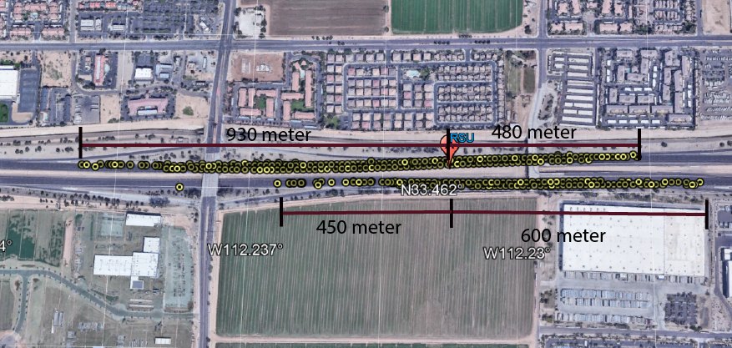
Analysis: Location-1
For the westbound approach, the RSU can receive the BSMs from a distance approximately 480 meter to the east and 930 meter to the west.
For the eastbound approach, the RSU can receive the BSMs from a distance approximately 600 meter to the east and 450 meter to the west.

Slide 21
Analysis: Location-1
During the test for westbound approach at location-1, the average vehicle speed was 60mph.
The time requires to enter the RSU range from the east (on a westbound approach)
Speed = 60mph, Range (east of the RSU) = 480 meter.
Time= 480*0.000621371*3600/60= 18 seconds (approximately)
The time requires to exit the RSU range on the west ( on a westbound approach)
Speed = 60mph, Range (right side of the RSU) = 930 meter.
Time= 930*0.000621371*3600/60= 35 seconds (approximately)

Slide 22
Analysis: Location-1
During the test for eastbound approach at location-1, the average vehicle speed was 60mph.
The time requires to exit the RSU range on the east (on an eastbound approach)
Speed = 60mph, Range (right side of the RSU) = 600 meter.
Time= 600*0.000621371*3600/60= 22seconds (approximately)
The time requires to enter the RSU range on the west (on an eastbound approach)
Speed = 60mph, Range (right side of the RSU) = 450 meter.
Time= 450*0.000621371*3600/60= 17 seconds (approximately)

Slide 23
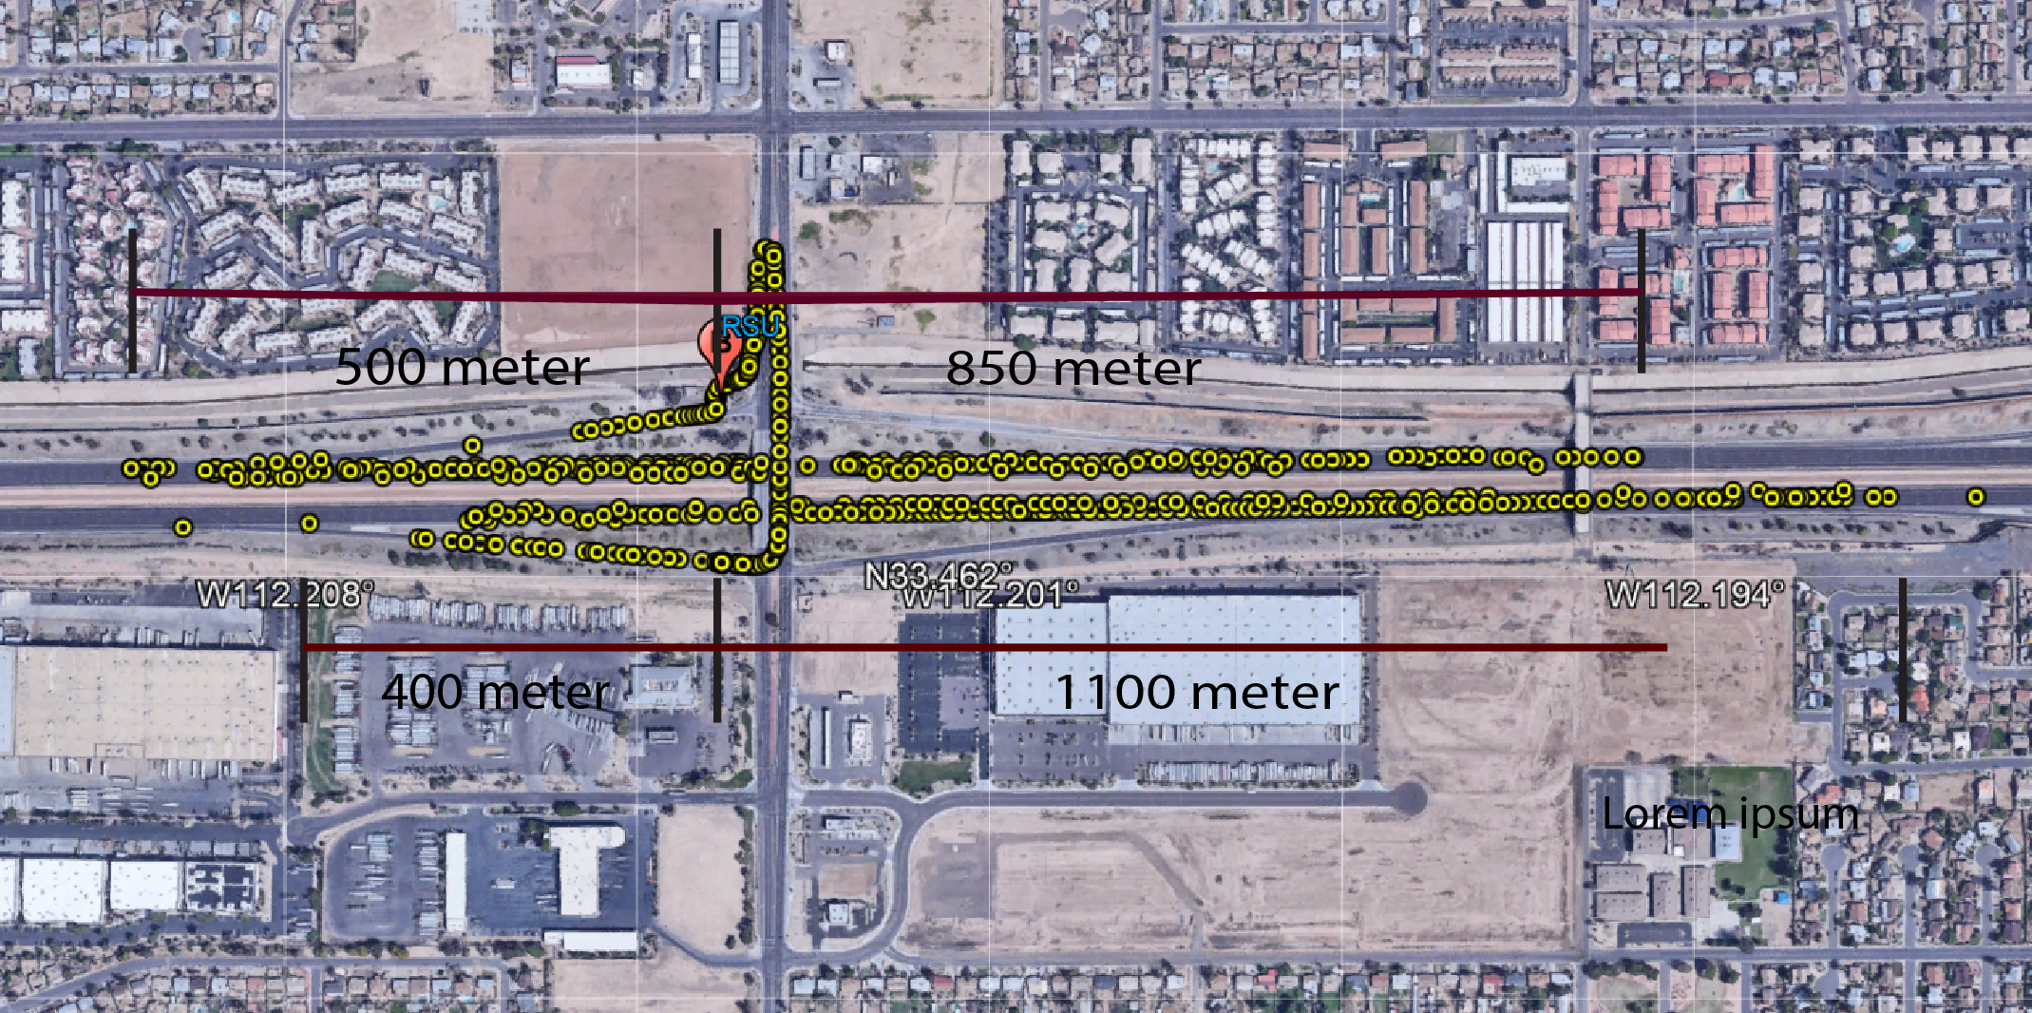
Analysis: Location-2
For the westbound approach, the RSU can receive BSMs from a distance approximately 850 meter to the east and 500 meter to the west.
For the eastbound approach, the RSU can receive BSMs from a distance approximately 1100 meter to the east and 400 meter to the west.

Slide 24
Analysis: Location-2
During the test for westbound approach at location-2, average vehicle speed was 60mph.
The time requires to enter the RSU range from the east (on a westbound approach)
Speed = 60mph, Range (right side of the RSU) = 850 meter.
Time= 850*0.000621371*3600/60= 32 seconds(approximately)
The time requires to exit the RSU range on the west (on a westbound approach)
Speed = 60mph, Range (right side of the RSU) = 500 meter.
Time= 500*0.000621371*3600/60= 19 seconds(approximately)

Slide 25
Analysis: Location-2
During the test for eastbound approach at location-2, average vehicle speed was 60mph.
The time requires to exit the RSU range to the east (eastbound approach)
Speed = 60mph, Range (right side of the RSU) = 1100 meter.
Time= 1100*0.000621371*3600/60= 41seconds (approximately)
The time requires to enter the RSU range to the west (on a n eastbound approach)
Speed = 60mph, Range (right side of the RSU) = 400 meter.
Time= 400*0.000621371*3600/60= 15 seconds (approximately)

